Slide 1






Data Analysis of Public Safety
(Traffic Violation)
Project Strategy
Contributed By
follow
Summary of Dataset
Introduction
Architecture diagram
List of contents
Sweety
Naveen
Yuchen
Ziqi

Slide 2
Introduction
Project Strategy
Summary of the datasets
Architecture diagram
AWS Services and OLTP
OLTP ERD
Problems to be solved
OLAP ERD
Tableau Dashboards
Challenges Faced?
Potential Use Cases
Conclusion & Reference
Architecture diagram
Project Strategy
Summary of Dataset
Introduction
Amazon Web Services
List of contents

Slide 3



In 2018, about 1.5 million people were fined in New York City for traffic violations, which reflects the high traffic density and strict law enforcement in the city.
By analyzing the violation data, we identified the most common code of violations, reasons for violations, and distribution of violations over the months and days of the week.
With the help of data management and visualization techniques, we extracted insights from the ticket data, such as the age group of violators and which courts handle the majority of cases.
Project Strategy
List of contents
Architecture diagram
Introduction
Amazon Web Services
Summary of Dataset
By comparing the data from different sources, such as motor vehicle crashes and violation codes, we identified patterns and correlations that can be used to improve traffic safety in the city.
The insights gained from this analysis can be used by policymakers and law enforcement agencies to develop effective traffic management strategies and reduce the number of traffic violations in the city.

Slide 4



Step
Step
Step
1
2
3
List of contents
Summary of Dataset
4 data sources load into S3 for processing
Perform ETL and normalization data
Store the data on Redshift
Project Strategy
Possible concerns to be addressed:
Architecture diagram
Amazon Web Services

Slide 5



Step
Step
Step
4
5
6
Summary of Dataset
Load data from Redshift to MySQL Workbench using Lambda.
List of contents
Possible concerns to be addressed:
Architecture diagram
Perform OLAP in MySQL Workbench
Connects to Tableau for reporting needs
Project Strategy
Amazon Web Services

Slide 6
Violators who get tickets are mainly distributed from Monday to Friday, or Saturday and Sunday?
What are the common violations of tickets?
Which age group is more likely to get a ticket? Below 20, 20-30, 30-40, 40-50, 50-60
In which court are the fines mainly concentrated?
Men and women, which gender is more likely to get a ticket?
What is the pattern of the tickets, and the motor vehicle crashes?
What leads to accidents, what are those patterns?
The common trends of the ticket and accident data. How can people avoid them?
Suggesting steps for people to be more careful and aware of traffic situations, tickets, and motor vehicle accidents can have a direct impact on society.
Project Strategy
Summary of Dataset
Architecture diagram
List of contents
Amazon Web Services
Possible concerns to be addressed:

Slide 7

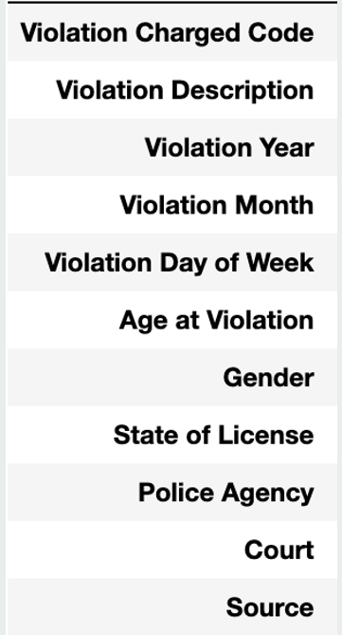
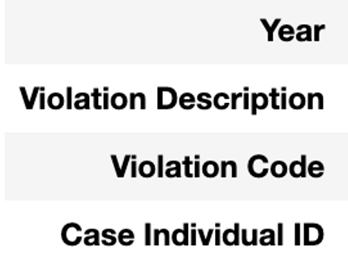
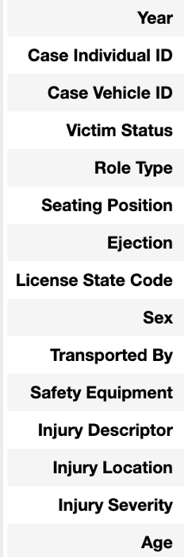
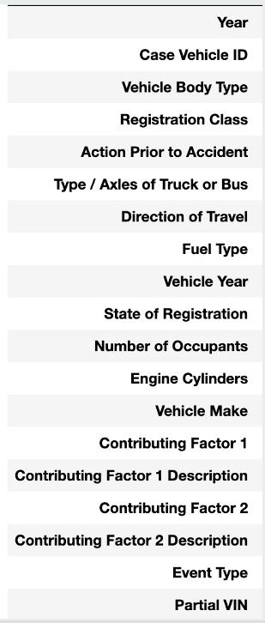
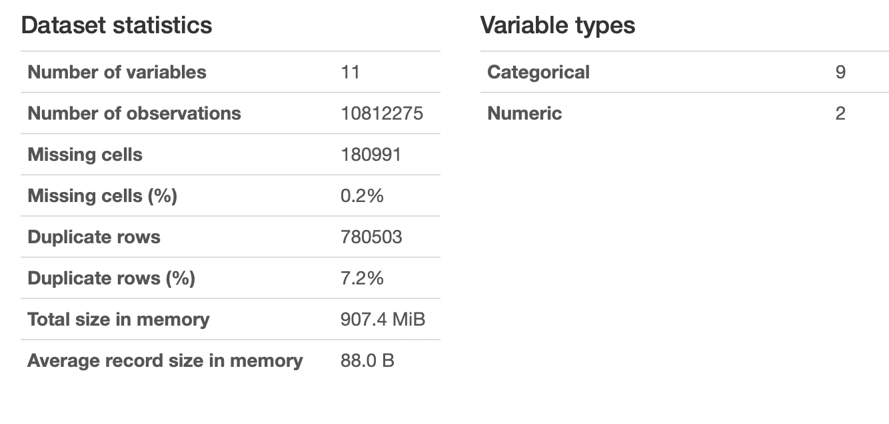
01
02
03
04
Traffic Tickets Issued
Motor Vehicle Crashes - Violation Information
Motor Vehicle Crashes - Individual Information
Motor Vehicle Crashes - Vehicle Information
Architecture diagram
Summary of Dataset
Project Strategy
Amazon Web Services
Possible concerns to be addressed:
List of contents

Slide 8
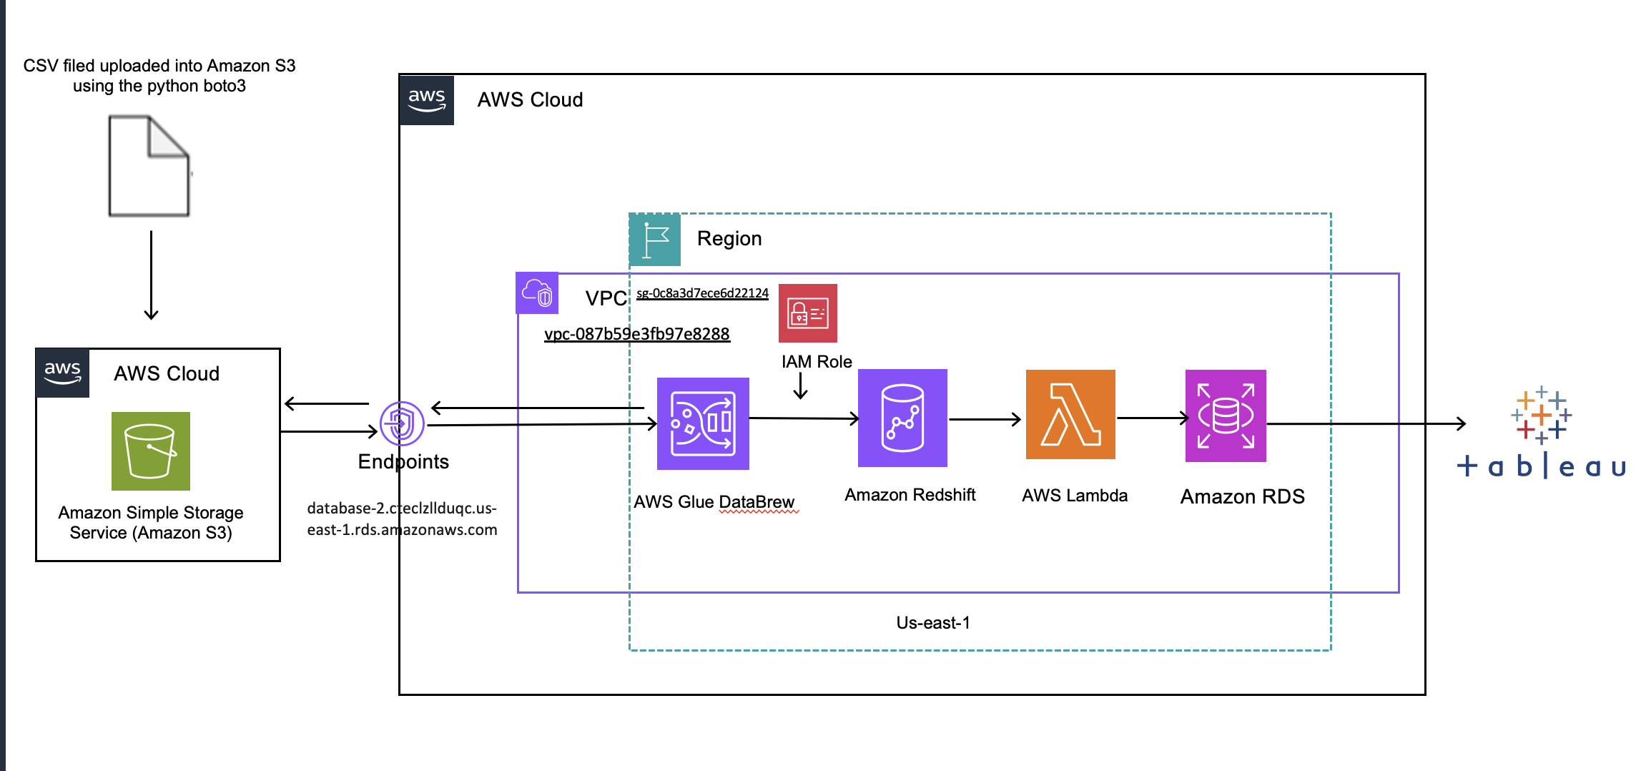
Possible concerns to be addressed:
Introduction
Amazon Web Services
Architecture diagram
List of contents

Slide 9
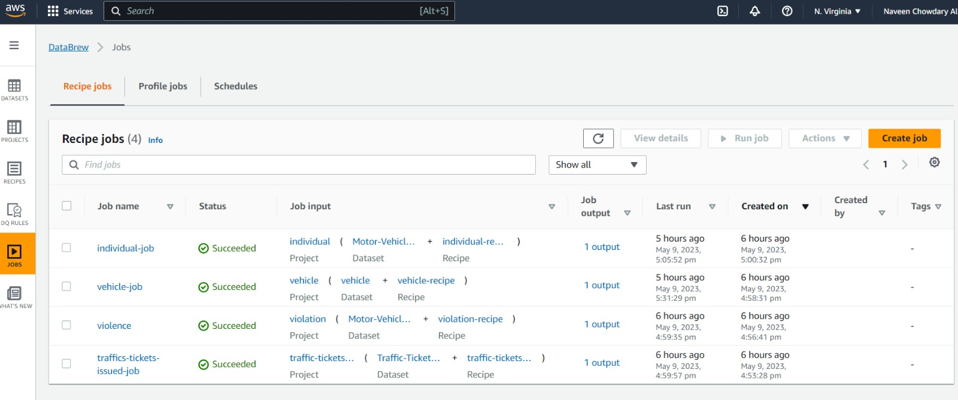
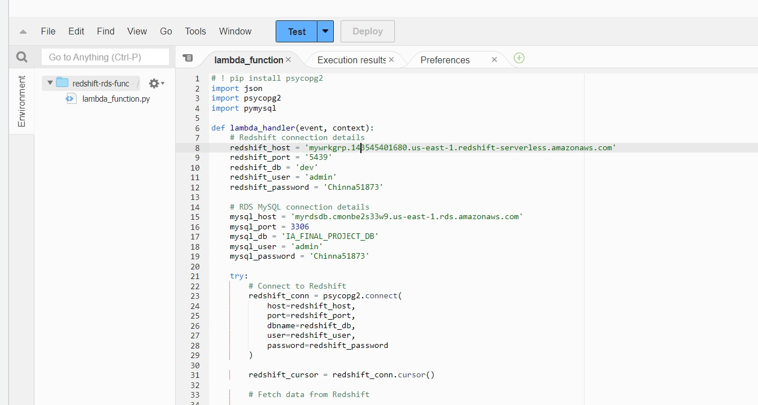
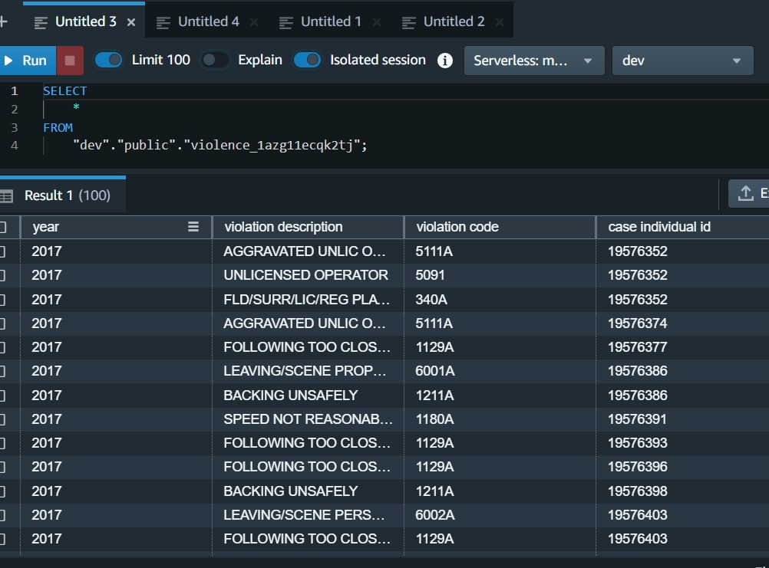


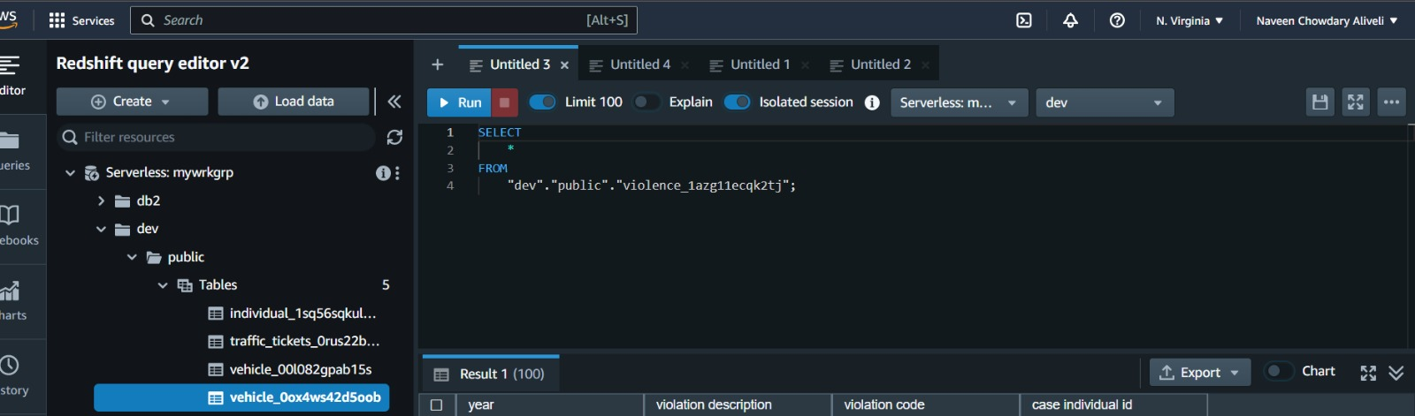
ETL Jobs run to migrate data from s3 to redshift
Create tables in redshift
Architecture diagram
Possible concerns to be addressed:
Introduction
Summary of Dataset
List of contents
Amazon Web Services
Use Lambda to move data to RDS MySQL
Redshift query editor

Slide 10
Migrated data from s3 to redshift

Slide 11
Tables crated in redshift

Slide 12
Run a query in redshift query editor to check data

Slide 13
Using Lambda function to move data from redshift to RDS MYSQL

Slide 14
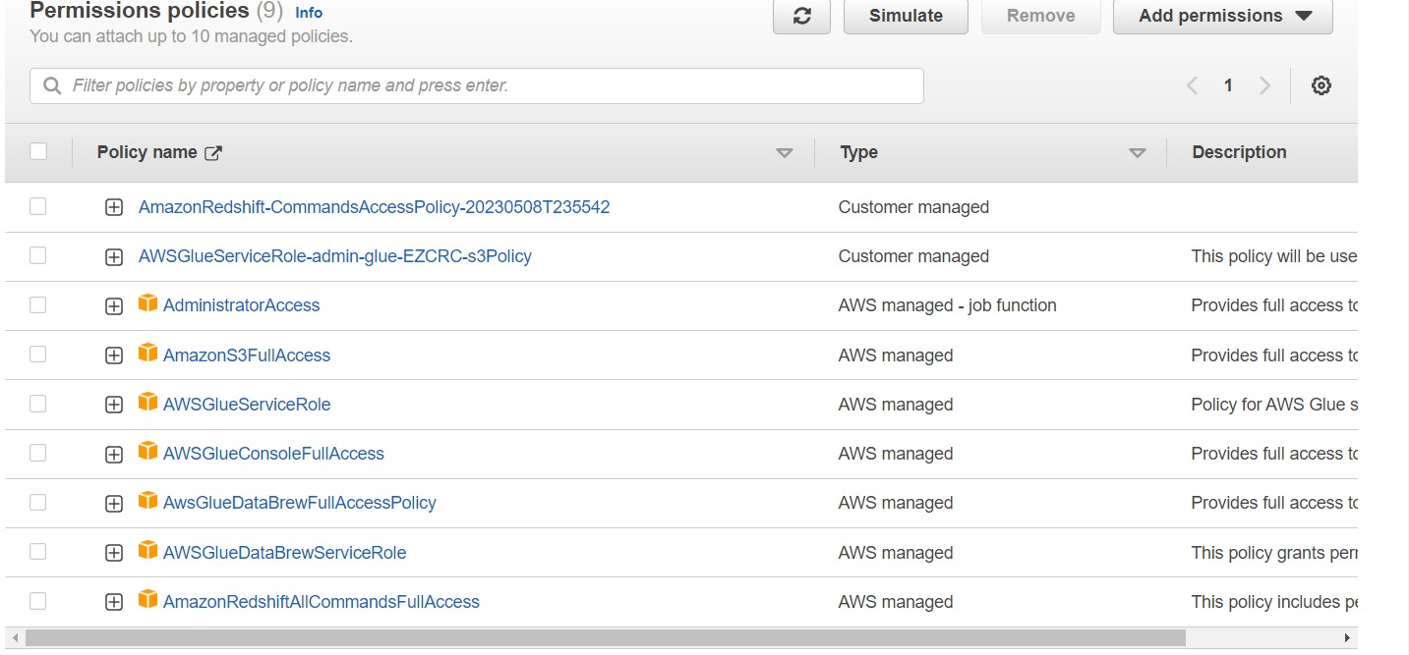
Policies needed for IAM role

Slide 15
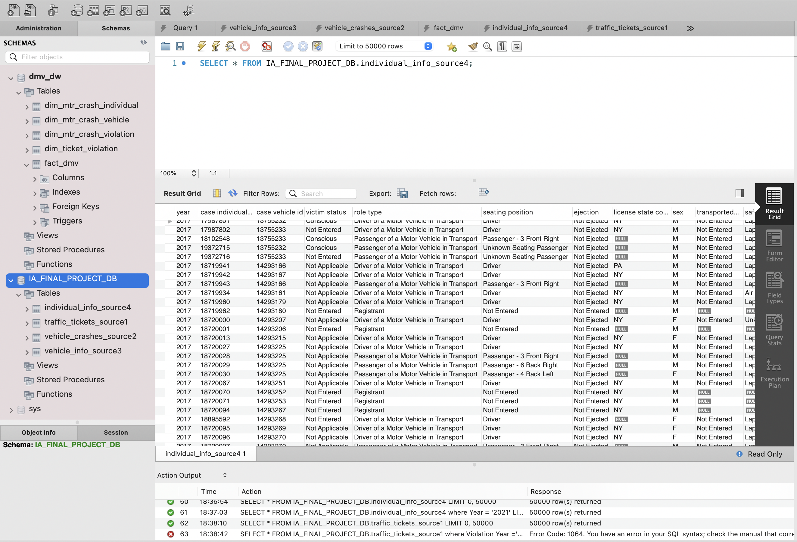
Data loaded in RDS MySQL

Slide 16
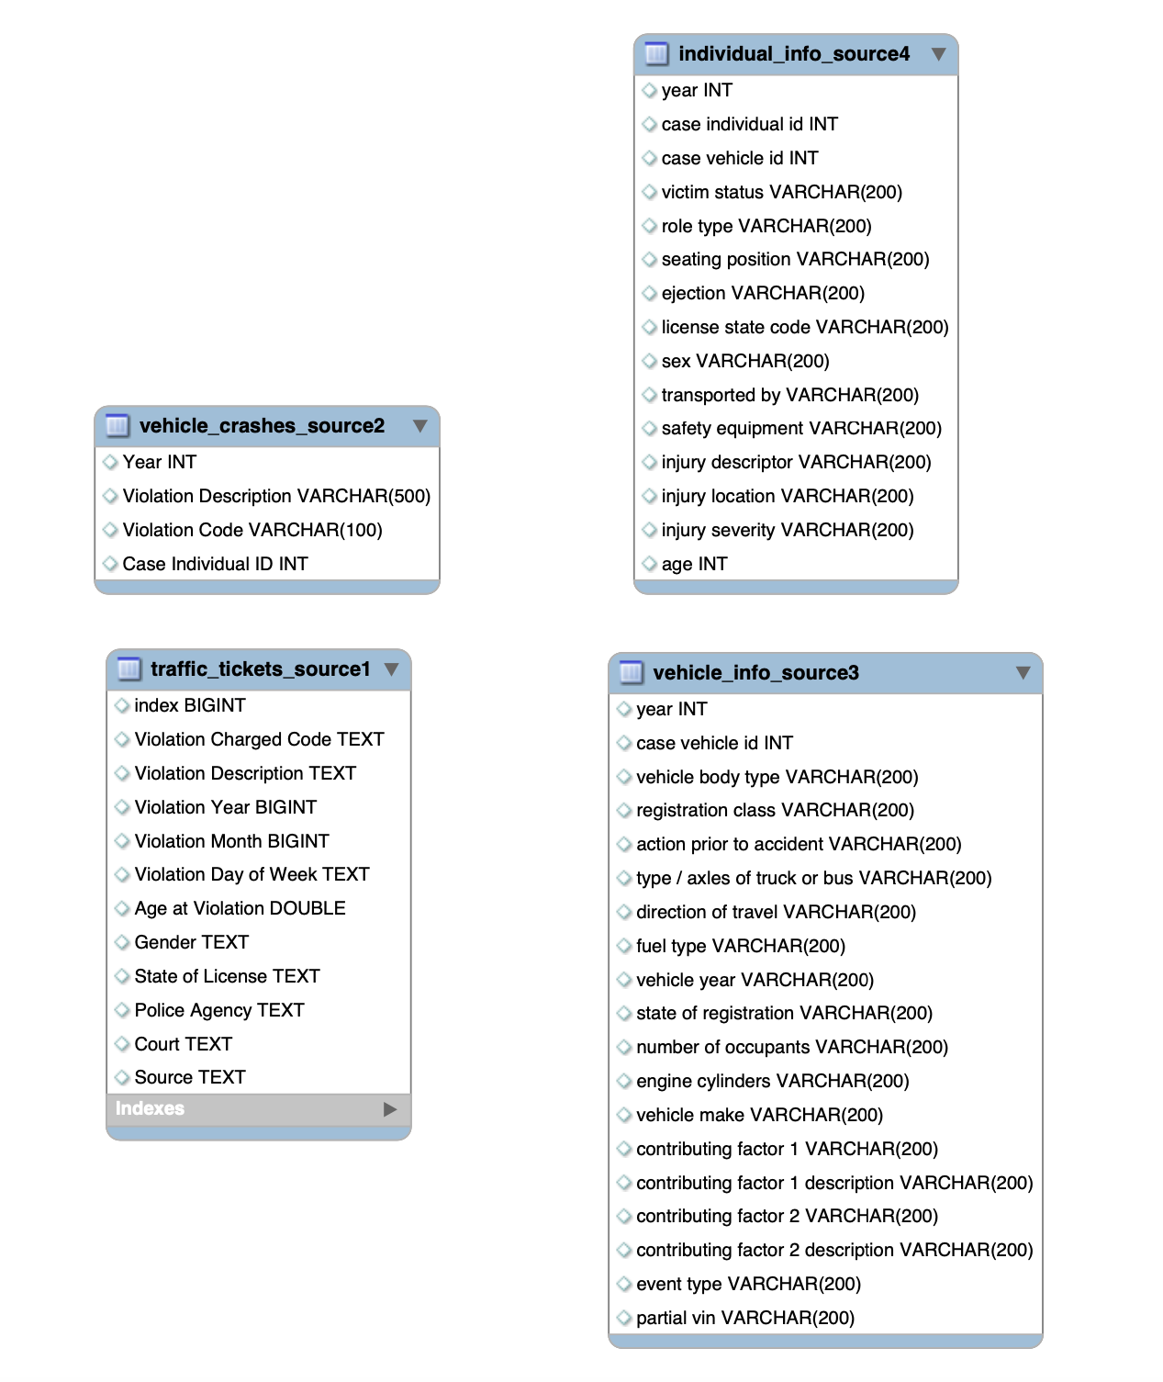
OLTP ERD

Slide 17
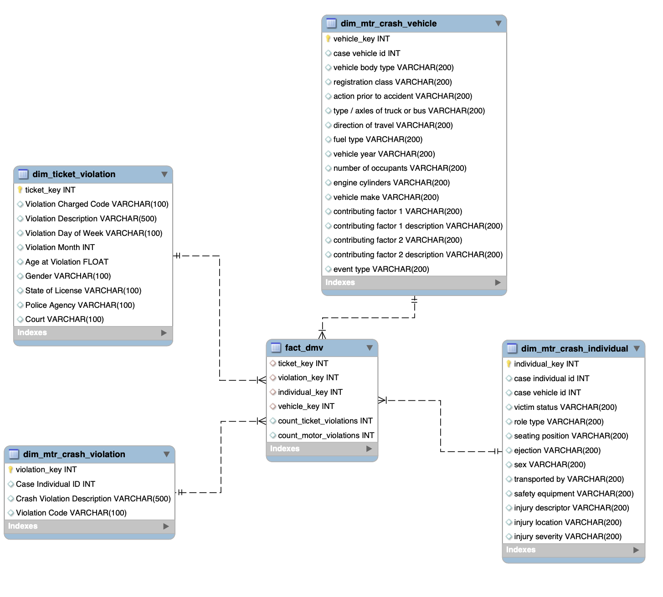
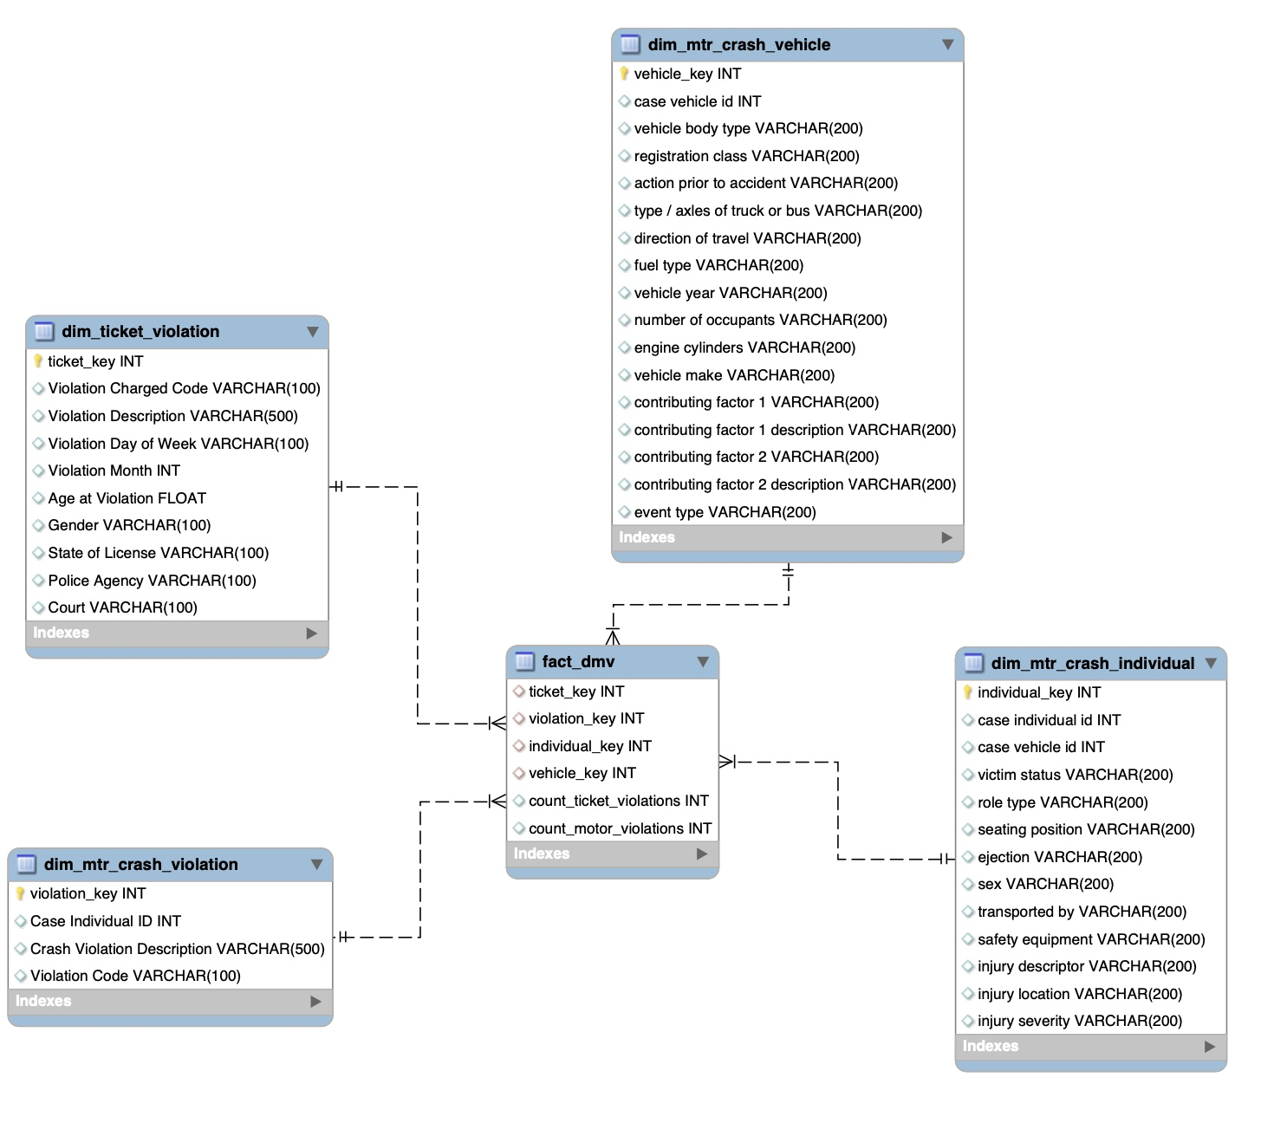
OLAP ERD

Slide 18
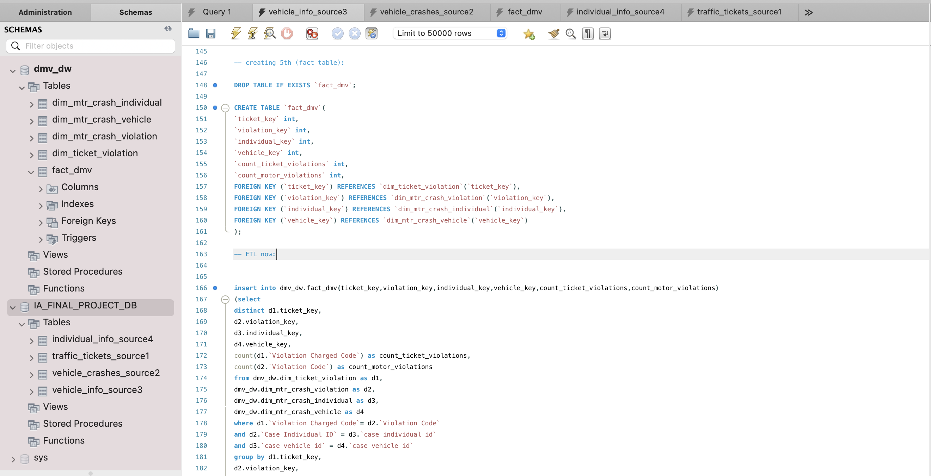

Slide 19
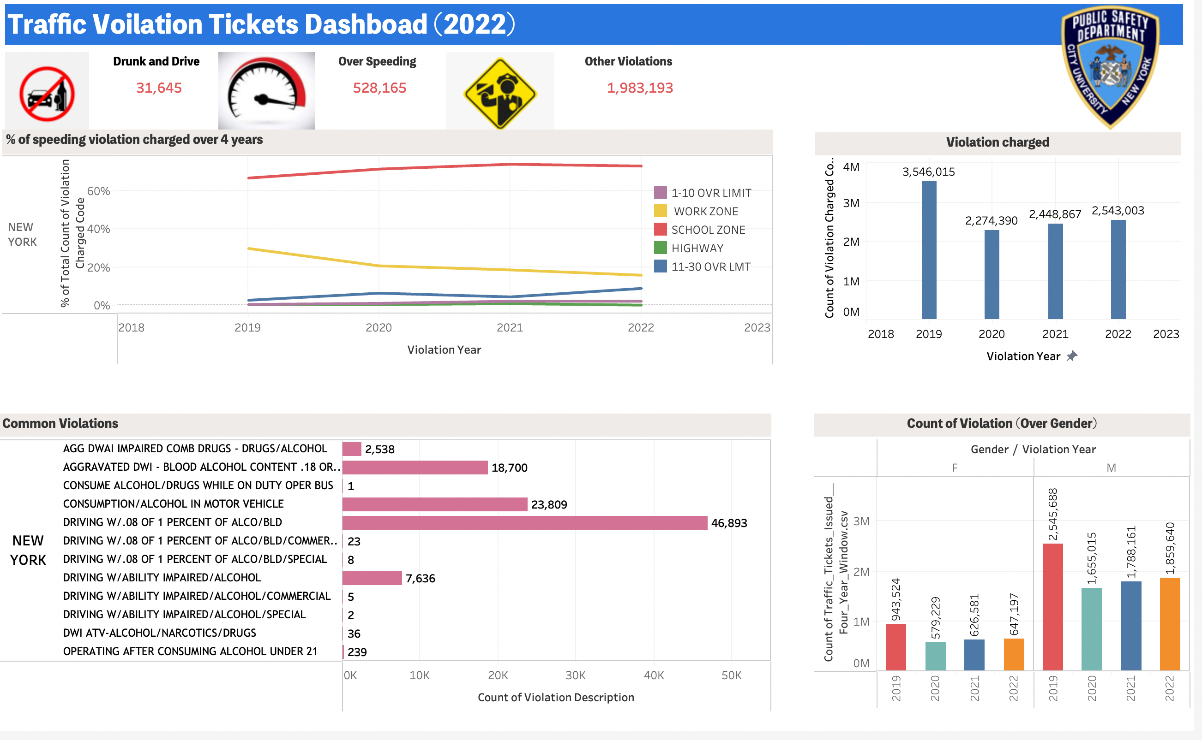

Slide 20
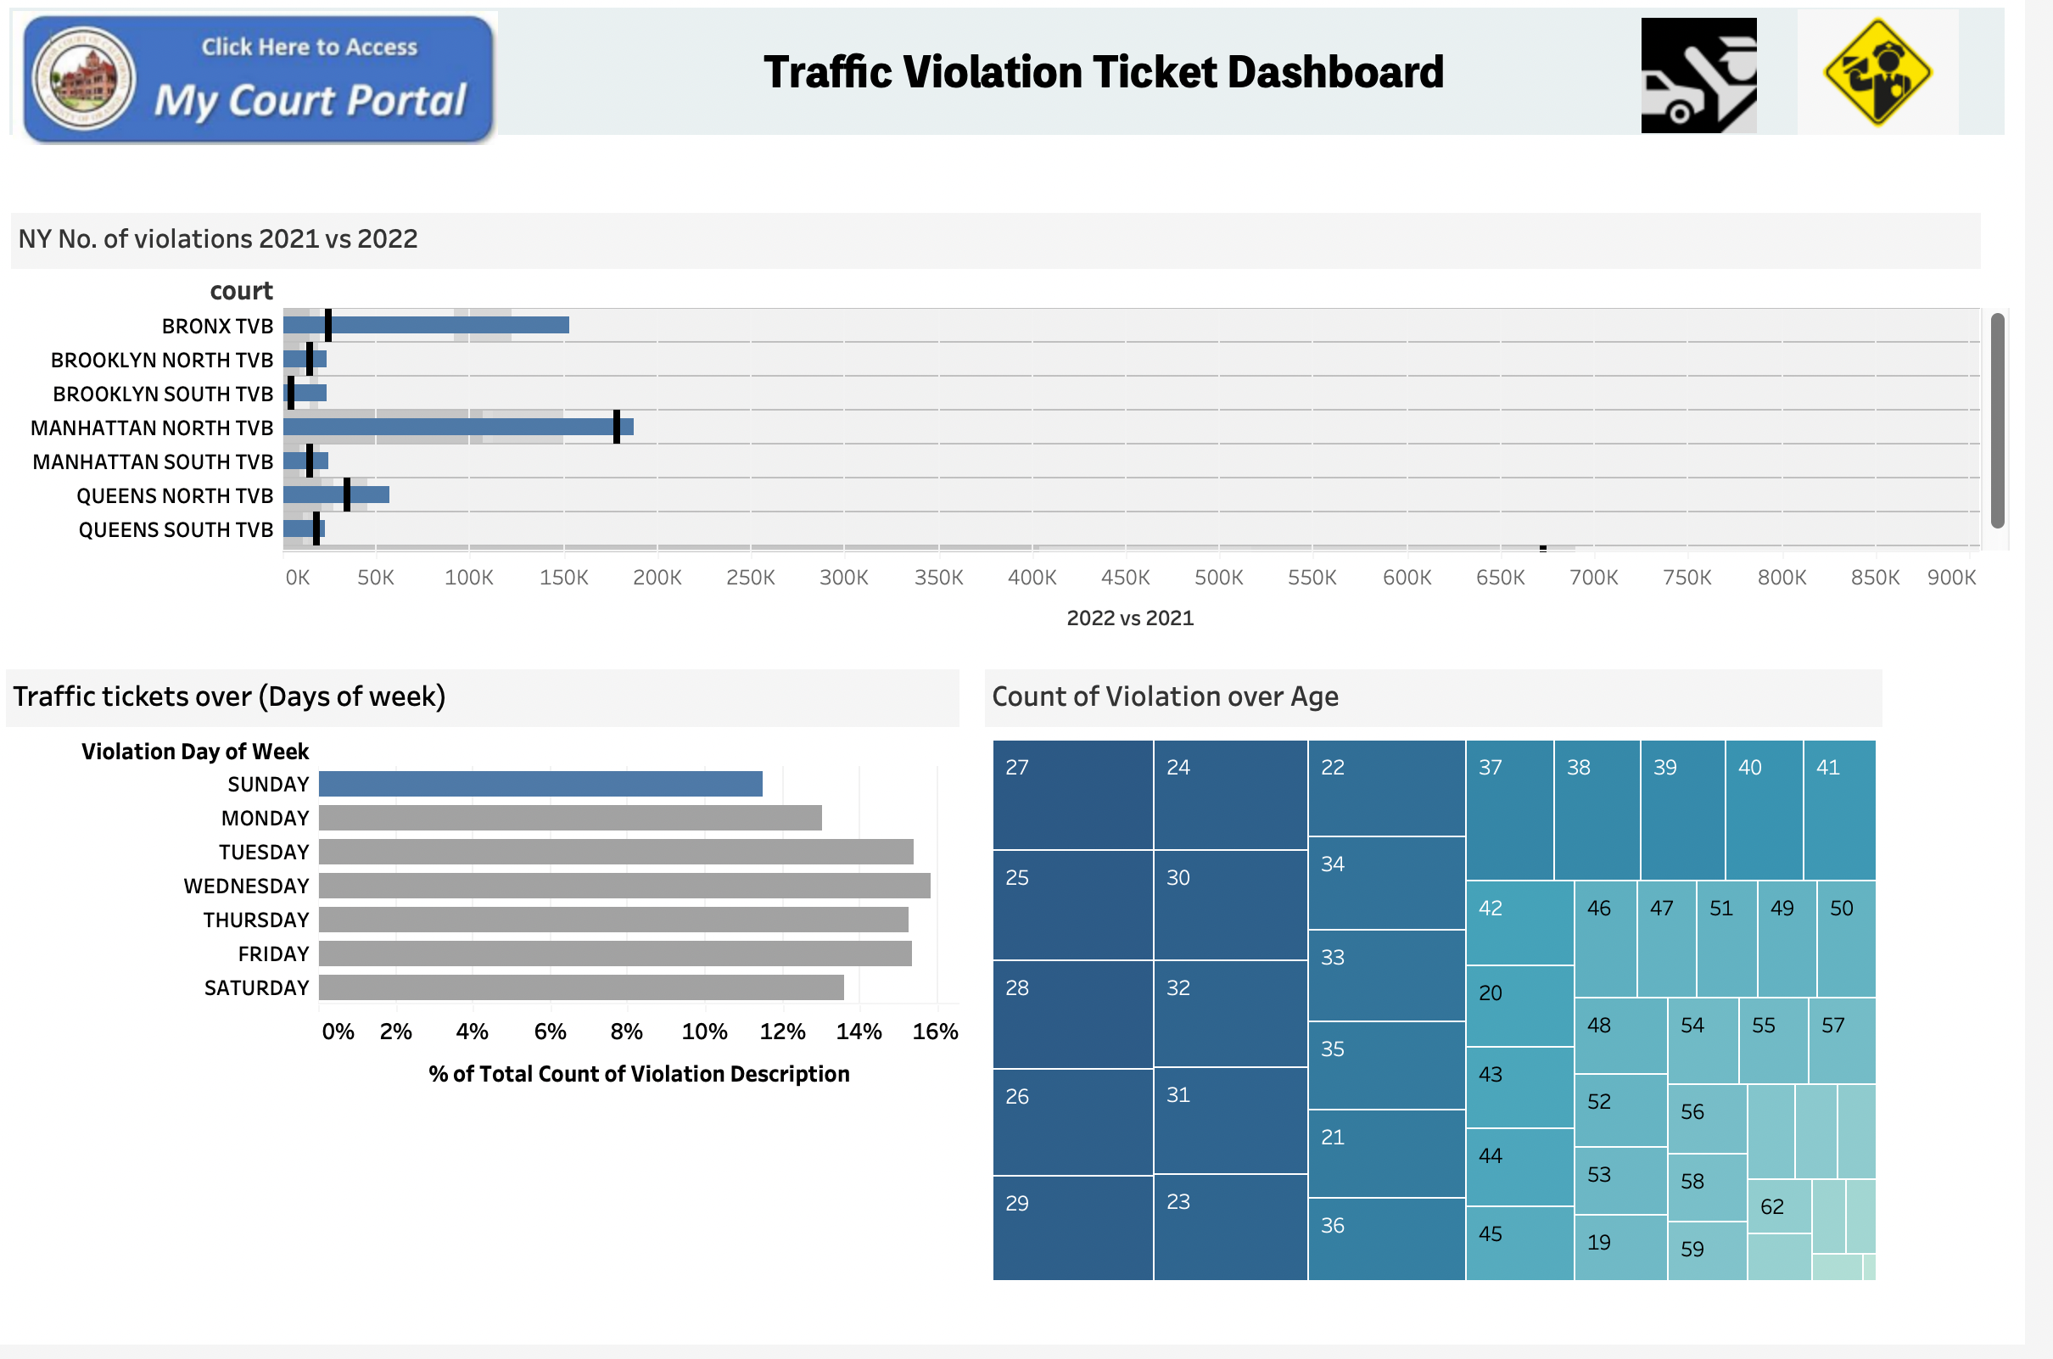

Slide 21


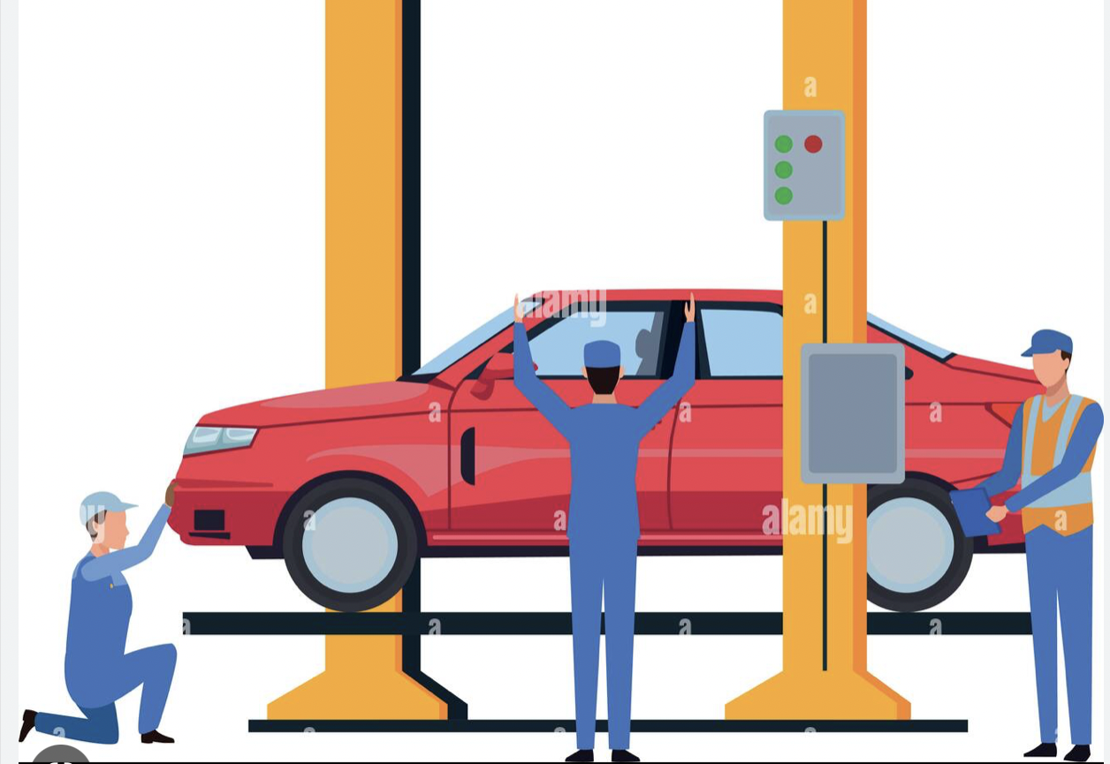

Potential Use Cases/User Profiles
Government Safety Officials
Automobile Manufacturers
Automobile Insurance Companies
Police Officials

Slide 22

Problems Faced:
Incomplete descriptors during ticket creation:
During the ticket creation process, many descriptors are not entered
Affects the quality of data analysis. The inclusion of these descriptors would be beneficial for better data insights.
Took a long time to successfully data loading in OLTP:
The large size of data creates challenges for data loading
Used Python Boto to load the data in MySQL
ETL delay issues in the data warehouse
We have processed data with around 10 million records with boto4 as we encountered challenges with the lambda function to load data from redshift to rds.

Slide 23

People are more likely to get tickets Monday through Friday, and fewer Saturdays and Sundays.
Common tickets include speeding, stop sign, violation of traffic signs, running red lights, and not wearing seat belts.
Drivers from the age of 20-30 are easy to get a ticket, and 50-60 years old are also easy to get a ticket. Other age groups get fewer fines.
The main reason for motor vehicle crashes from our analysis is that animal action is the most, followed by a driver not being attentive and backing irresponsibly.
There are fewer fines in December-February and more in other months
The courts where the fines are mainly concentrated are: MANHATTAN SOUTH TVB, QUEENS NORTH TVB, BROOKLYN SOUTH TVB
We also noticed that a lot of data goes missing in traffic tickets as well as motor vehicle crashes tickets, which gives the interpretation that better data quality checks and standardization should be there.
Conclusion

Slide 24

Reference
https://data.ny.gov/Transportation/Traffic-Tickets-Issued-Four-Year-Window/q4hy-kbtf
https://data.ny.gov/Transportation/Motor-Vehicle-Crashes-Violation-Information-Three-/abfj-y7uq
https://data.ny.gov/Transportation/Motor-Vehicle-Crashes-Individual-Information-Three/ir4y-sesj
https://data.ny.gov/Transportation/Motor-Vehicle-Crashes-Vehicle-Information-Three-Ye/xe9x-a24f

Slide 25


